Slide 1
…

Slide 2

Funded by the Horizon 2020 programme
of the European Union
Welcome!
to the
Training on the
Hotmaps database and toolbox
29th June – 17th July 2020, Europe

Slide 3
Background
Climate change
Low CO₂ economy and energy system is necessary
Heating and cooling is highly relevant
Heating and cooling needs long term planning
Aim of Hotmaps: assist long term planning in heating and cooling

Slide 4
Hotmaps – What for?
Hotmaps develops, demonstrates and disseminates a toolbox to support public authorities, energy agencies and planners in strategic heating and cooling planning at local, regional and national levels, and in line with EU policies.

Slide 5
Aim of the event
Learning & Training
After the training you should know how to use the Hotmaps database and toolbox for analysing and planning heating and cooling in a selected region
Testing
The event will also serve as further test of the tools and the platform and most probably assist to increase stability, usability and credibility

Slide 6
Hotmaps – The 3 pillars
User-driven: developed in close collaboration with 7 European pilot areas
Open source: the developed tool and all related modules will run without requiring any other commercial tool or software. Use of and access to Source Code is subject to Open Source License
EU-28 compatible and adaptable: the tool will be applicable for cities in all 28 EU Member States by default and users can upload their own data

Slide 7

The experts behind the project

Slide 8
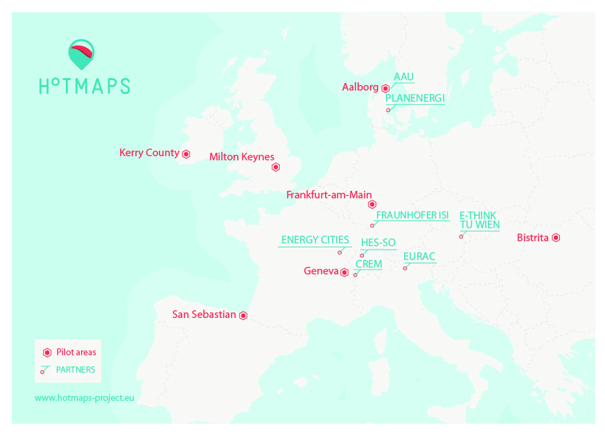
Regional overview

Slide 9
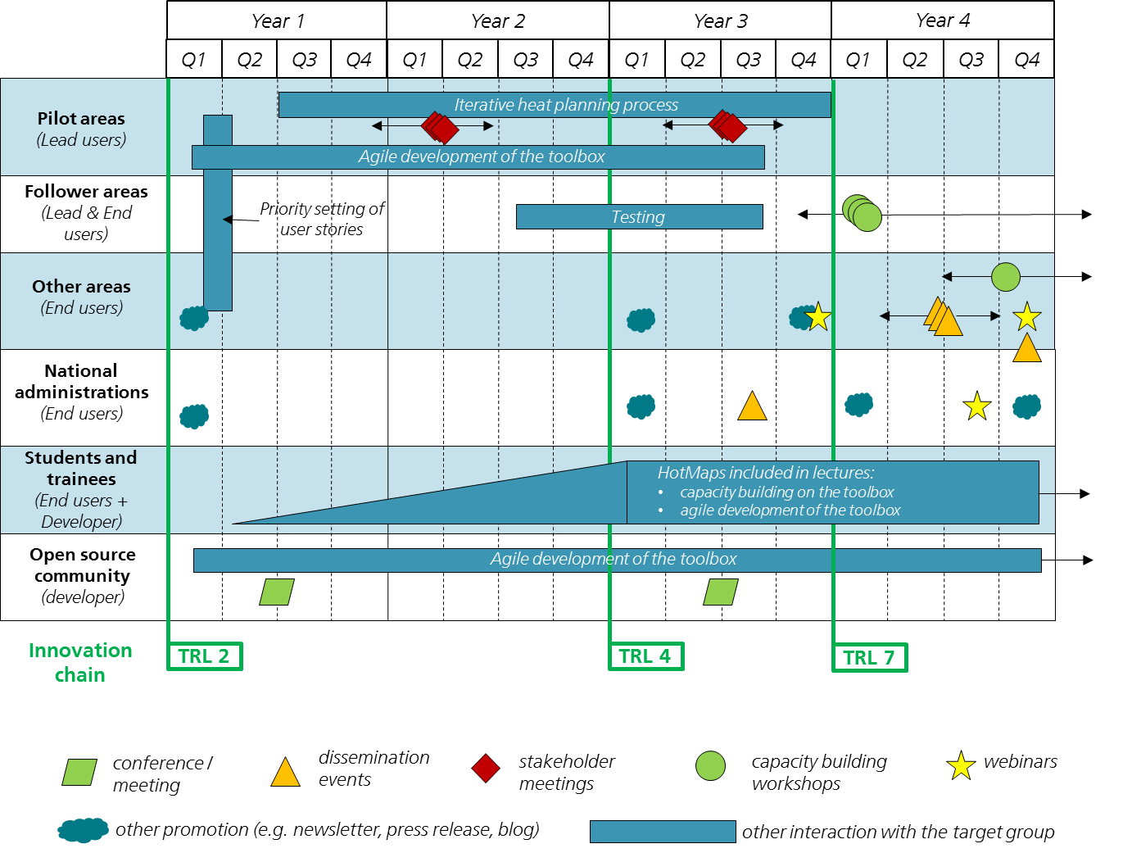
Context & timing
5 x 1½ days WS
Sept 2020
Online course
1 x ½ day WS

Slide 10
Technology Readiness Levels
TRL 7 – System prototype demonstration in operational environment
TRL 8 – System complete and qualified
TRL 9 – Actual system proven in operational environment (competitive manufacturing in the case of key enabling technologies; or in space)
Not in scope of the project → not during project lifetime

Slide 11
Agile software development
Since the beginning of 2019 we have had a release every 3-4 months:
Beta release Jan. 2019
Release V1.0.0 Apr. 2019
Release V2.0.0 Aug. 2019
Release V3.0.0 Dec. 2019
Further releases before the project ends

Slide 12
Status of the database and toolbox
Database:
For many data necessary for heating and cooling analysis default data are in the database; however, not all data contained and data not necessarily correct
In course of the Hotmaps project no further changes will be done
Follow-up project for further elaboration just recently started
Toolbox:
Numerous automated and manual tests have been performed on stability and usability for all release versions
In this release it’s the first time that all CMs relevant for the toolchain are included
Still we cannot be sure that no errors occur
We have 2 servers that will be used
Wiki:
Still has to be improved
Most information should be contained and findable

Slide 13
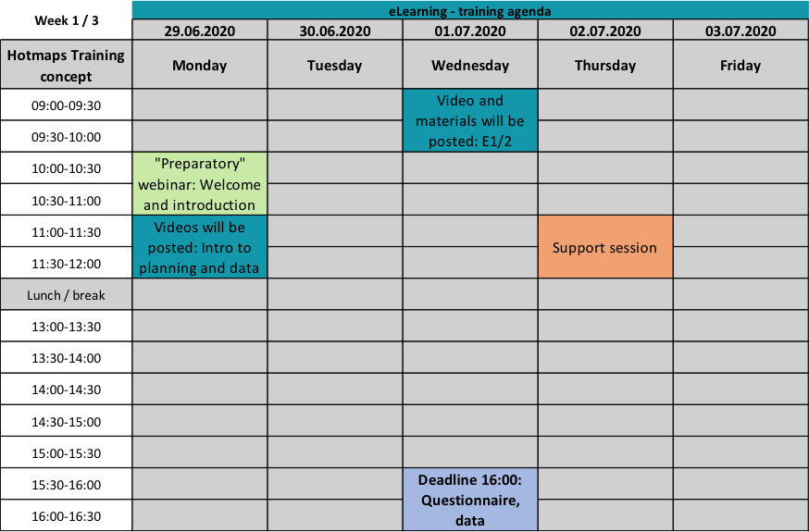
Agenda of the training
Hotmaps_eLearning_Info_short_EN_2020-06.pdf

Slide 14
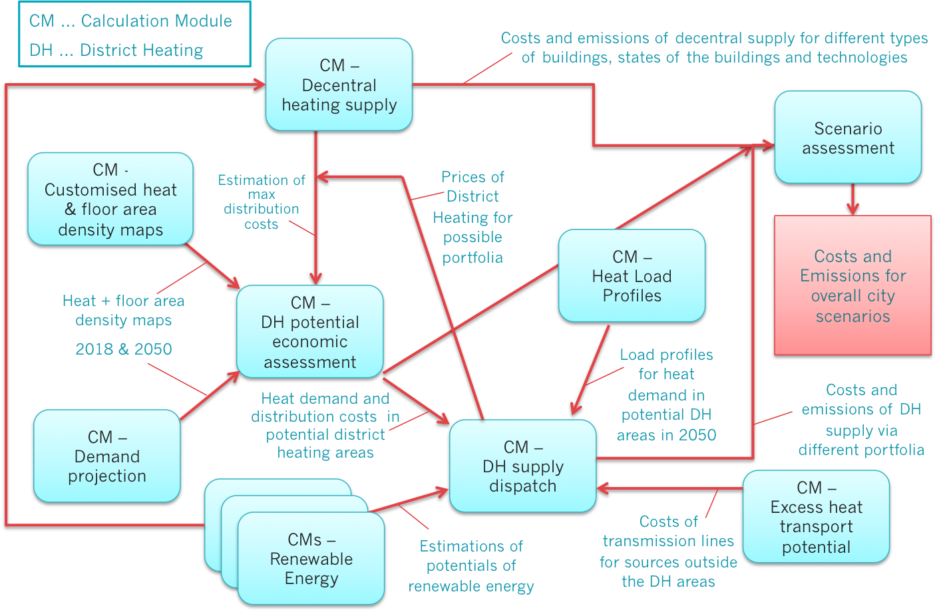
Scenario Toolchain – Guidelines

Slide 15
Scenario Toolchain – Training
CM … Calculation Module
DH … District Heating
SS … Spread Sheet
Transfer of results from the CMs for selected scenarios
E2
CM –
Decentral heating supply
E5
SS – CM in/out
SS – Scenario assessment
E2
E4
CM –
Demand projection
CM –
DH potential - economic assessment
Indicators for overall city scenarios
Copy results to respective sheets, or find further information in SS
Use the resulting Heat & floor area density maps 2050
E4
CM –
DH potential – user-defined thresholds
E3
CM –
DH supply dispatch
E3
Optional
CM –
Scale Heat and Cool density maps
CM –
Excess heat transport potential
Make a heat density layer reflecting DH demand with the CM
Results already taken into account in the given input values

Slide 16
Toolbox web address
www.hotmaps.eu

Slide 17
The training platform
Google Classrom https://classroom.google.com/
Sign in to/Register your Google account,
click Join class and provide the code: fmkpos2
OR accept the invitation received by email
In the classroom you will find:
STREAM: a wall with updates
CLASSWORK: all material, assignments and tests
PEOPLE: your trainers and classmates

Slide 18
More Hotmaps links
Toolbox: www.hotmaps.eu
Project website: www.hotmaps-project.eu
Open Source Data for download: https://gitlab.com/HotMaps
Open Source Modules for download: https://github.com/HotMaps

Slide 19
What’s next
Access the training platform https://classroom.google.com/ code: fmkpos2
Watch the Tutorial and Introductory Videos and submit the quiz not later than July 1st 4 PM
Next appointments:
Wednesday 1th July 9 AM: Video recording of Exercise 1 and 2 will be posted on Google Classroom
Thursday 2nd July 11-12 AM: Live support session
More info and assigned support group by email

Slide 20
Have fun!
&
Please ask, if you have any question!

Slide 21
Zentrum f. Energiewirtschaft und Umwelt (e-think)
hummel@e-think.ac.at

